Slide 1
Dynamics 365 F&O Business events and the Dataverse(and data Events too!)

Slide 2

Nathan Clouse
Technical Architect enVista Corp.
Microsoft Business Applications MVP (3x)
nclouse@envistacorp.com
www.atomicax.com
www.dynamics.fo
@NathanClouseAX
Nathan Clouse
Technical Architect, Microsoft MVP
enVista Corp.

Slide 3

Sukrut Parab
Director of Development
Hitachi Solutions America Ltd
Microsoft Business Applications MVP (3x)
sparab@hitachisolutions.com
https://elearnd365.com/
@SukrutParab
Sukrut Parab
Director, Microsoft MVP
Hitachi Solutions.

Slide 4
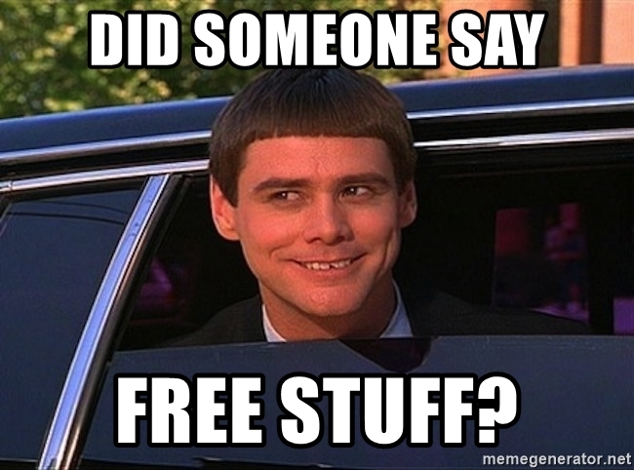
Gift Card Giveaway
….. At the end

Slide 5
This session will focus on how Business Events can be used to enhance F&O using Power Platform products to respond. We will also discuss Data Events (cousin of Business Events), walk through a scenario as well as a demo discussion of the solution

Slide 6
What are business events ?
Business Event Catalog
Business event endpoints
Active Events
Inactive Events
Errors and error handling
Security
What is Dataverse ?
Power platform Integration
Data events
Demo

Slide 7
Business events

Slide 8

What is a business event?
Alerts outside system of an event via notification.
Outside systems can receive the message and action upon it
Can be workflow related or not
Some processes supported OOTB
Anything not in the catalog should be created custom

Slide 9
Catalog
System administration > Set up > Business events
List all available business events
Static processes like an AR payment has been posted
More dynamic such as a events related to a specific configured workflow in F&O
Activate
Download Schema

Slide 10
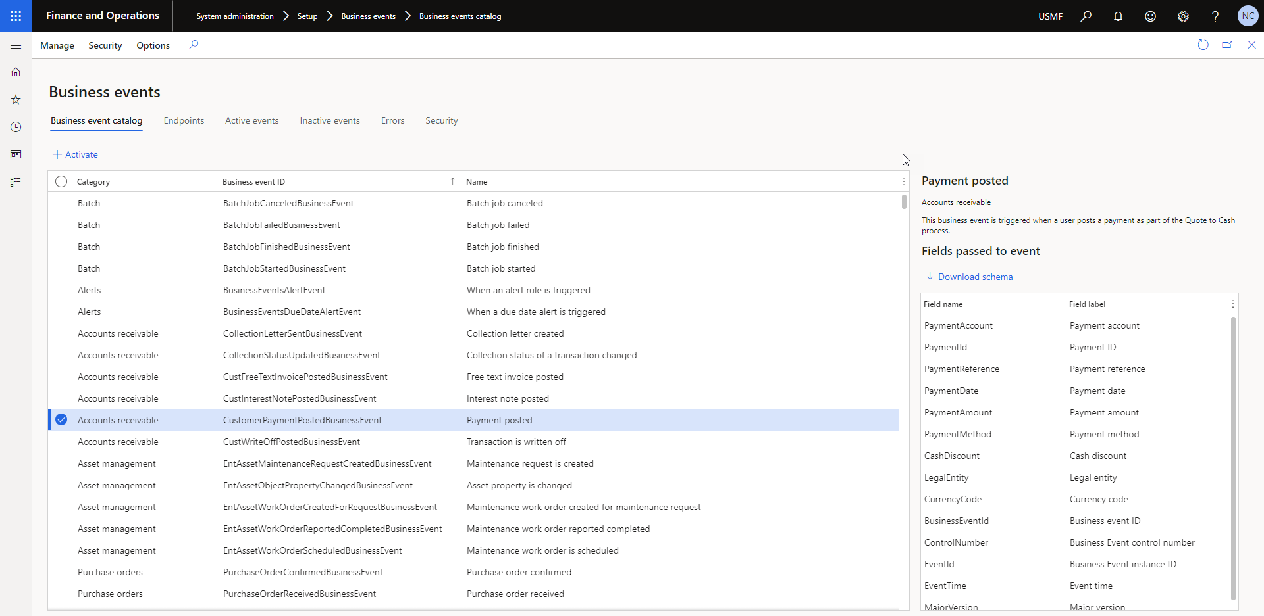
Catalog

Slide 11
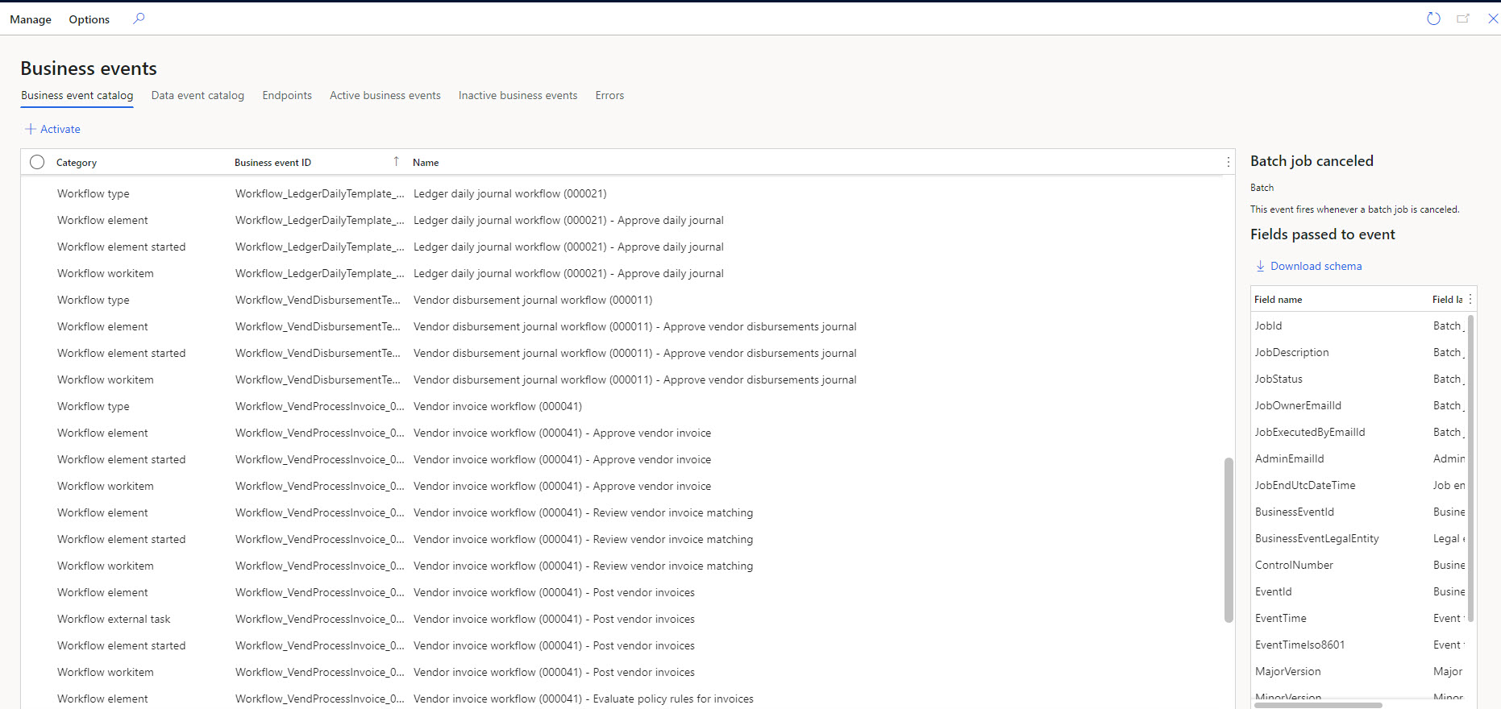
Catalog

Slide 12
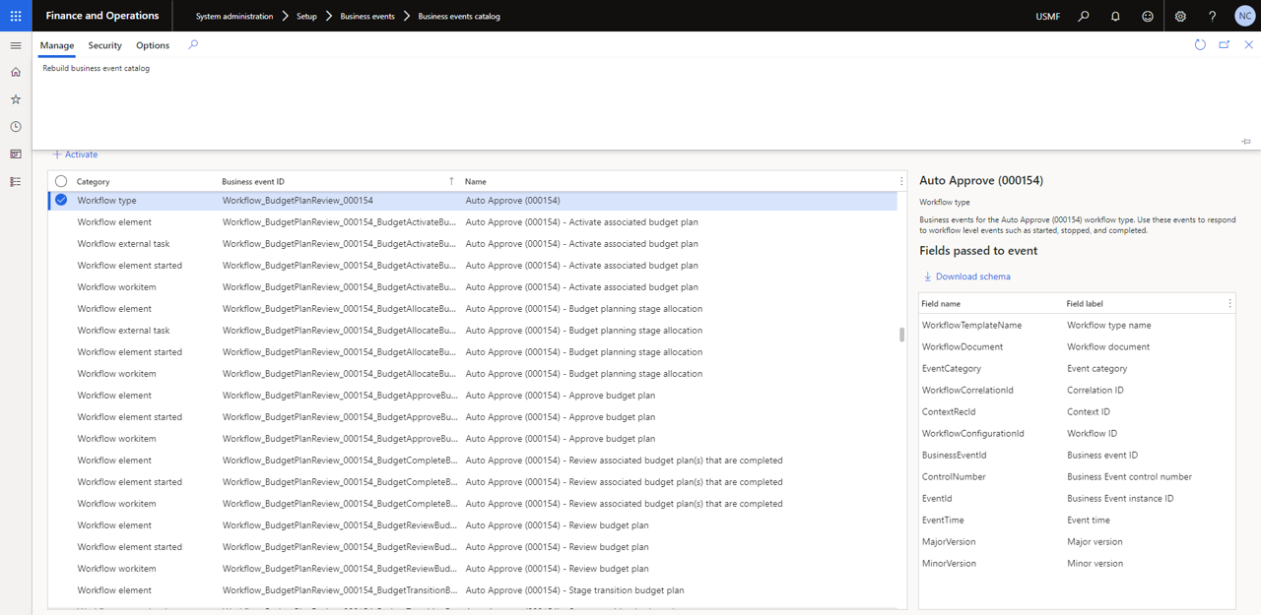
Catalog
Notes:
The business event catalog is built during database synchronization at the time of deployment. You can build it explicitly using this button.
The catalog also shows the list of data fields that will be sent out in the event.
Right hand side has download schema button.
In scenarios where external integration systems require the schema of the payload for a business event during development, you can select Download schema to download the JavaScript Object Notation (JSON) schema.

Slide 13
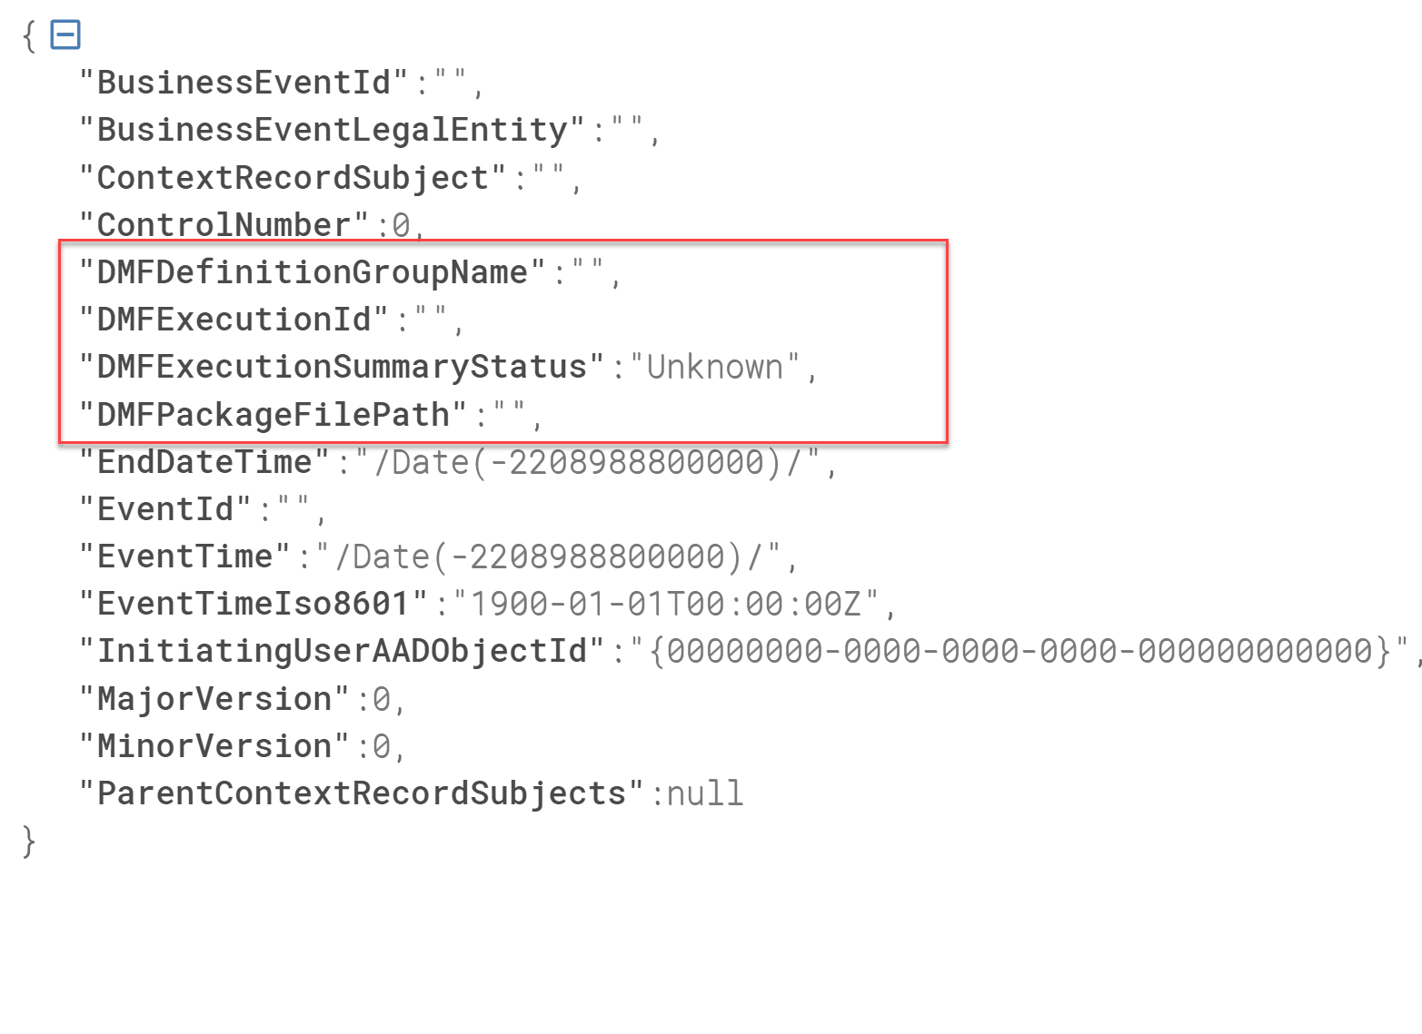
Schema Sample
Custom Business event - Data project execution

Slide 14

Endpoints
Azure Service Bus queue
Azure Service Bus Topic
Azure Event Grid
Azure Event Hub
Power Automate*
HTTPS
Azure Blob Storage
Custom – Build Your Own

Slide 15
Dataverse

Slide 16
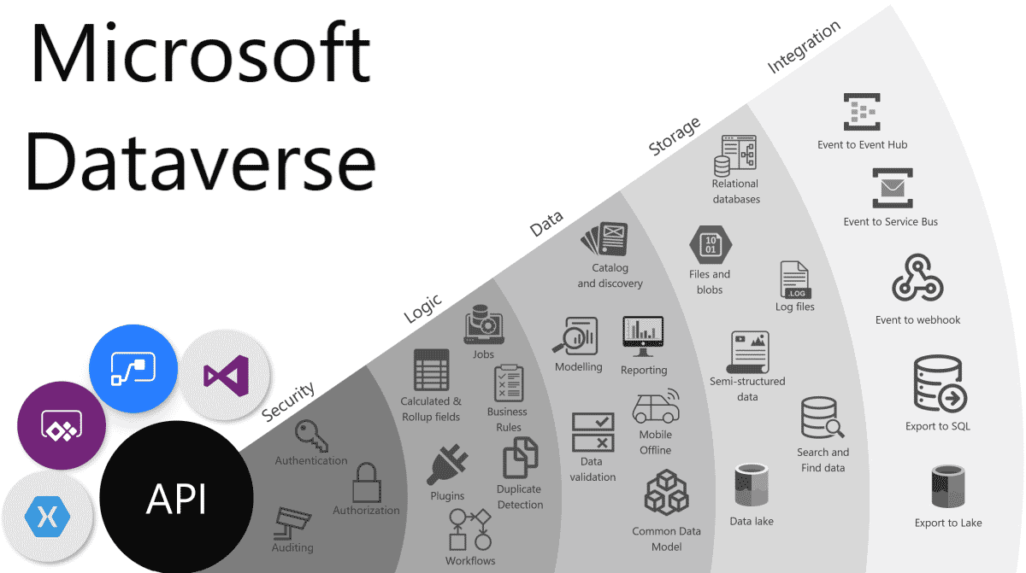
What is Dataverse

Slide 18
What is Dataverse

Slide 19
Power platform integration

Slide 20

What is PPAC?
Power Platform Admin Center
Environments
Analytics
Resources
Help + support
Data integration
Data gateways
Data policies
Notes:
Environments View, create, and manage your environments. Select an environment to see details and manage its setting. More information: Manage environment settings
Analytics Get a detailed view of key metrics for Microsoft Power Platform apps. More information: Microsoft Dataverse analytics
Resources More information: View and manage resources
Help + support Get a list of self-help solutions or create a support ticket for technical support. More information: Get Help + Support
Data integration More information: Integrate data into Dataverse
Data gateways More information: Set up data transfer between on-premises data and cloud services
Data policies More information: Create and manage data loss prevention policies.

Slide 21
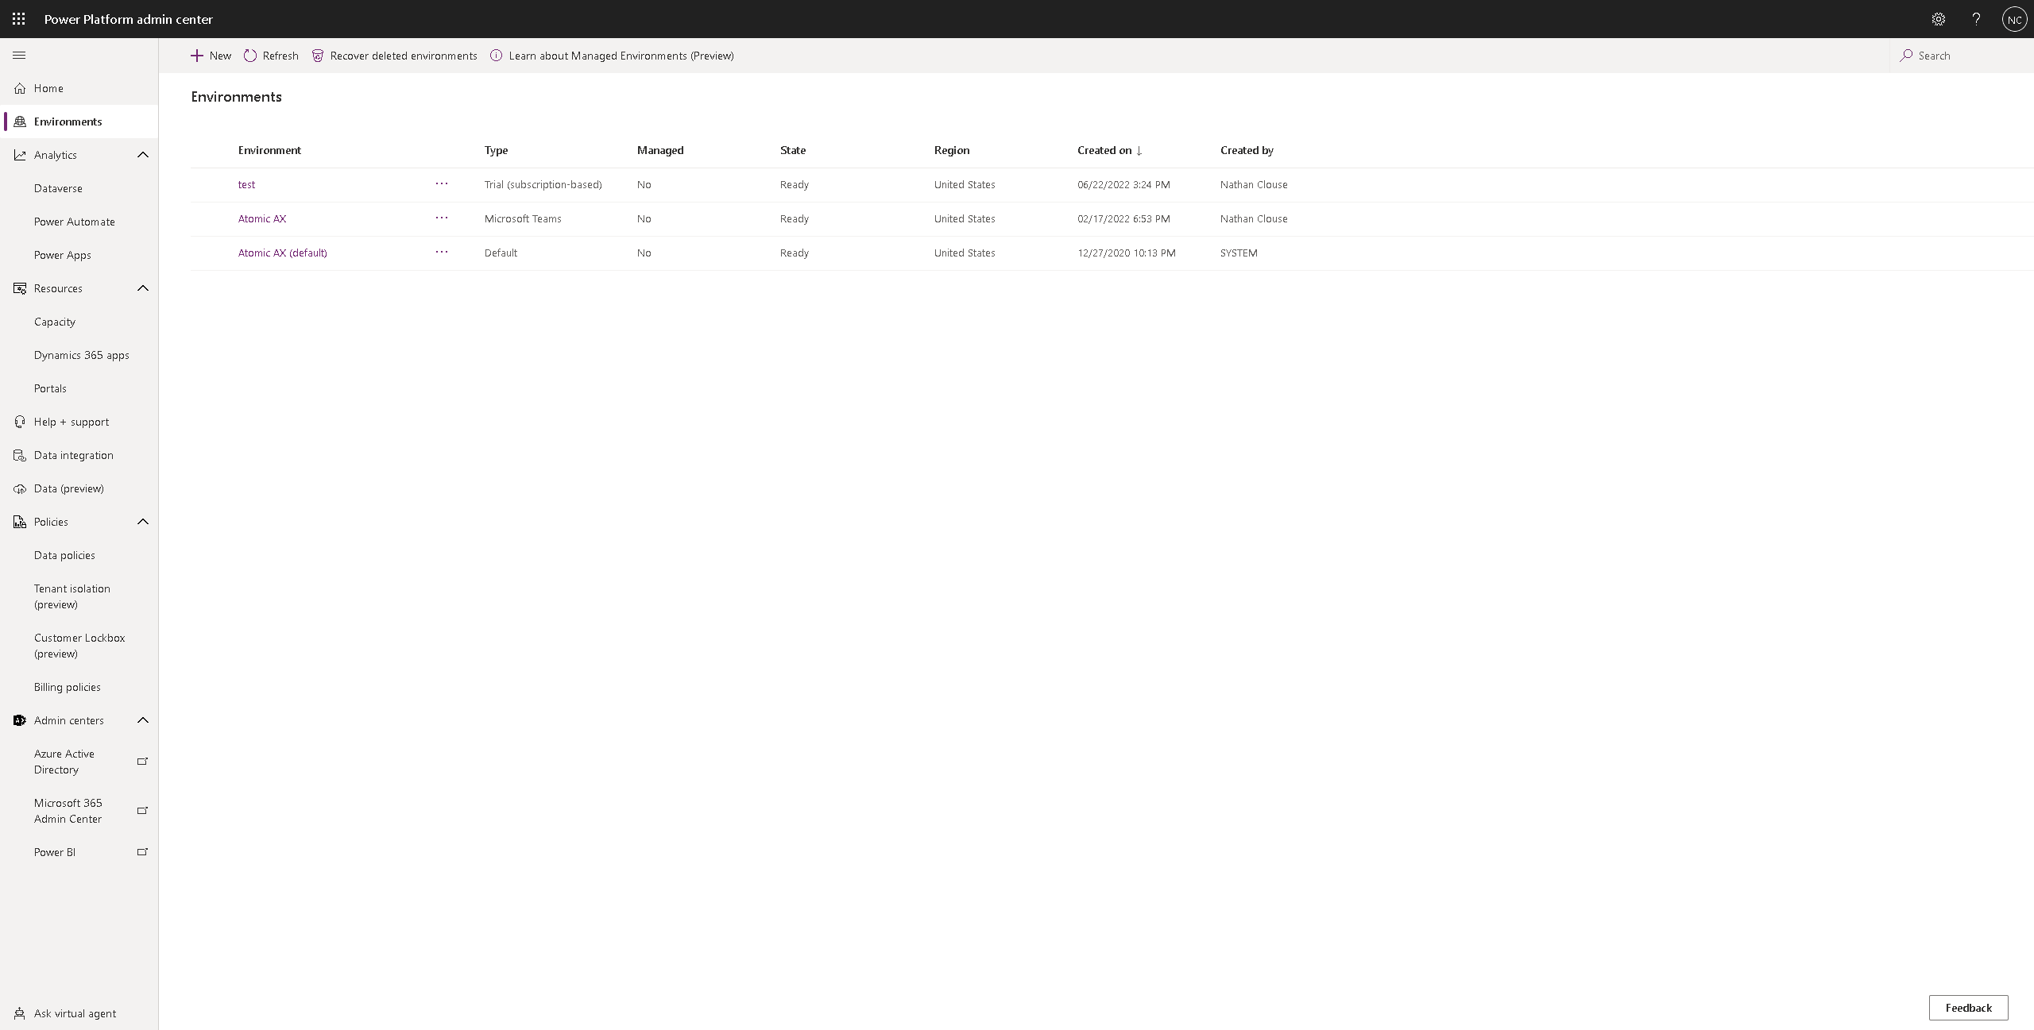
Notes:
Environments View, create, and manage your environments. Select an environment to see details and manage its setting. More information: Manage environment settings
Analytics Get a detailed view of key metrics for Microsoft Power Platform apps. More information: Microsoft Dataverse analytics
Resources More information: View and manage resources
Help + support Get a list of self-help solutions or create a support ticket for technical support. More information: Get Help + Support
Data integration More information: Integrate data into Dataverse
Data gateways More information: Set up data transfer between on-premises data and cloud services
Data policies More information: Create and manage data loss prevention policies.

Slide 22
Notes:
Environments View, create, and manage your environments. Select an environment to see details and manage its setting. More information: Manage environment settings
Analytics Get a detailed view of key metrics for Microsoft Power Platform apps. More information: Microsoft Dataverse analytics
Resources More information: View and manage resources
Help + support Get a list of self-help solutions or create a support ticket for technical support. More information: Get Help + Support
Data integration More information: Integrate data into Dataverse
Data gateways More information: Set up data transfer between on-premises data and cloud services
Data policies More information: Create and manage data loss prevention policies.

Slide 23
Notes:
Environments View, create, and manage your environments. Select an environment to see details and manage its setting. More information: Manage environment settings
Analytics Get a detailed view of key metrics for Microsoft Power Platform apps. More information: Microsoft Dataverse analytics
Resources More information: View and manage resources
Help + support Get a list of self-help solutions or create a support ticket for technical support. More information: Get Help + Support
Data integration More information: Integrate data into Dataverse
Data gateways More information: Set up data transfer between on-premises data and cloud services
Data policies More information: Create and manage data loss prevention policies.

Slide 24
Notes:
Environments View, create, and manage your environments. Select an environment to see details and manage its setting. More information: Manage environment settings
Analytics Get a detailed view of key metrics for Microsoft Power Platform apps. More information: Microsoft Dataverse analytics
Resources More information: View and manage resources
Help + support Get a list of self-help solutions or create a support ticket for technical support. More information: Get Help + Support
Data integration More information: Integrate data into Dataverse
Data gateways More information: Set up data transfer between on-premises data and cloud services
Data policies More information: Create and manage data loss prevention policies.

Slide 25
Notes:
Environments View, create, and manage your environments. Select an environment to see details and manage its setting. More information: Manage environment settings
Analytics Get a detailed view of key metrics for Microsoft Power Platform apps. More information: Microsoft Dataverse analytics
Resources More information: View and manage resources
Help + support Get a list of self-help solutions or create a support ticket for technical support. More information: Get Help + Support
Data integration More information: Integrate data into Dataverse
Data gateways More information: Set up data transfer between on-premises data and cloud services
Data policies More information: Create and manage data loss prevention policies.

Slide 26
Notes:
Environments View, create, and manage your environments. Select an environment to see details and manage its setting. More information: Manage environment settings
Analytics Get a detailed view of key metrics for Microsoft Power Platform apps. More information: Microsoft Dataverse analytics
Resources More information: View and manage resources
Help + support Get a list of self-help solutions or create a support ticket for technical support. More information: Get Help + Support
Data integration More information: Integrate data into Dataverse
Data gateways More information: Set up data transfer between on-premises data and cloud services
Data policies More information: Create and manage data loss prevention policies.

Slide 27
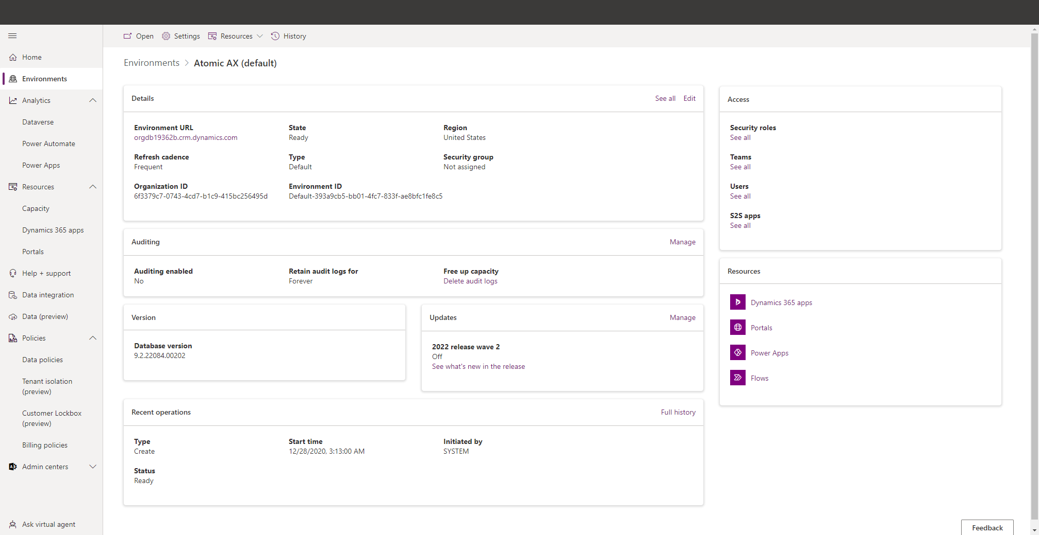

Slide 30

Power Apps maker Portal
Just where you Power Apps live
Can make, use, modify Power Apps
Modify Dataverse tables/entities for the environment you are in
https://make.powerapps.com/

Slide 31
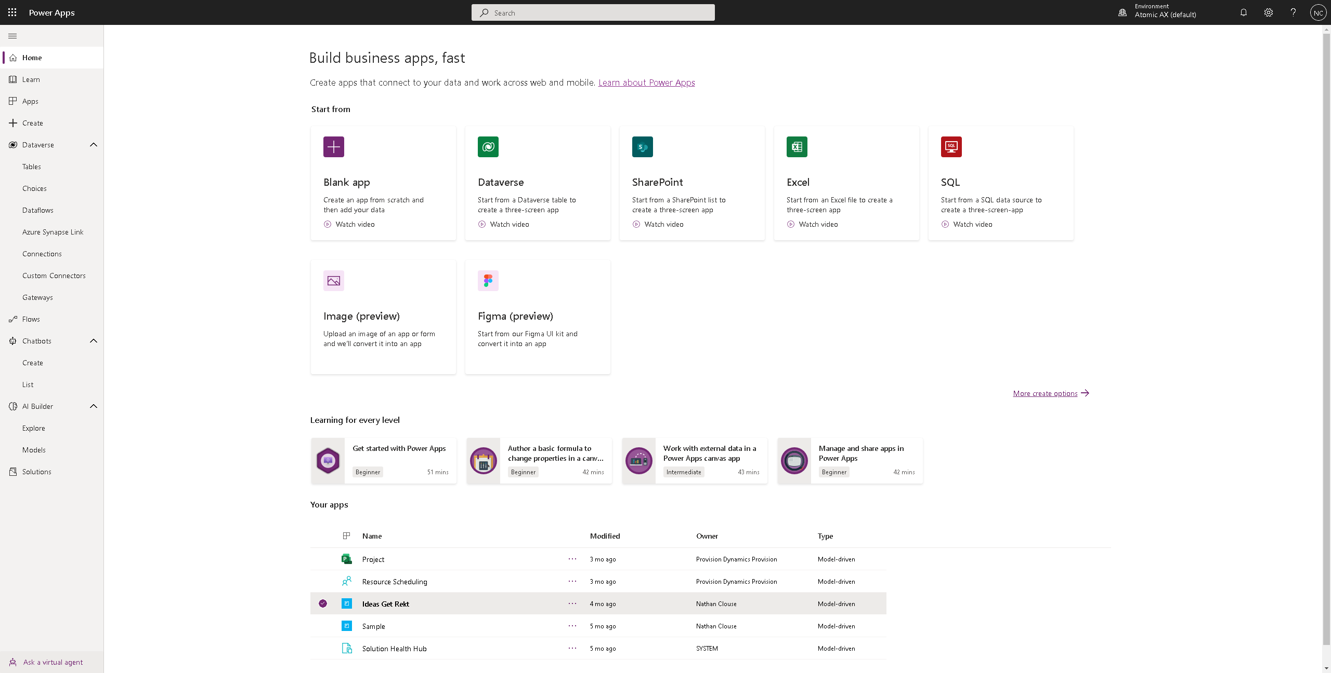

Slide 36
Platform Convergence
Everything we’re talking about right now
Use Power Platform tools with your F&O data
Bringing together the Power Platform plus F&O into a unified experience in Power Platform Admin Center (PPAC)
Dataverse is included with F&O – 10 GBs of capacity
Dual Write

Slide 37
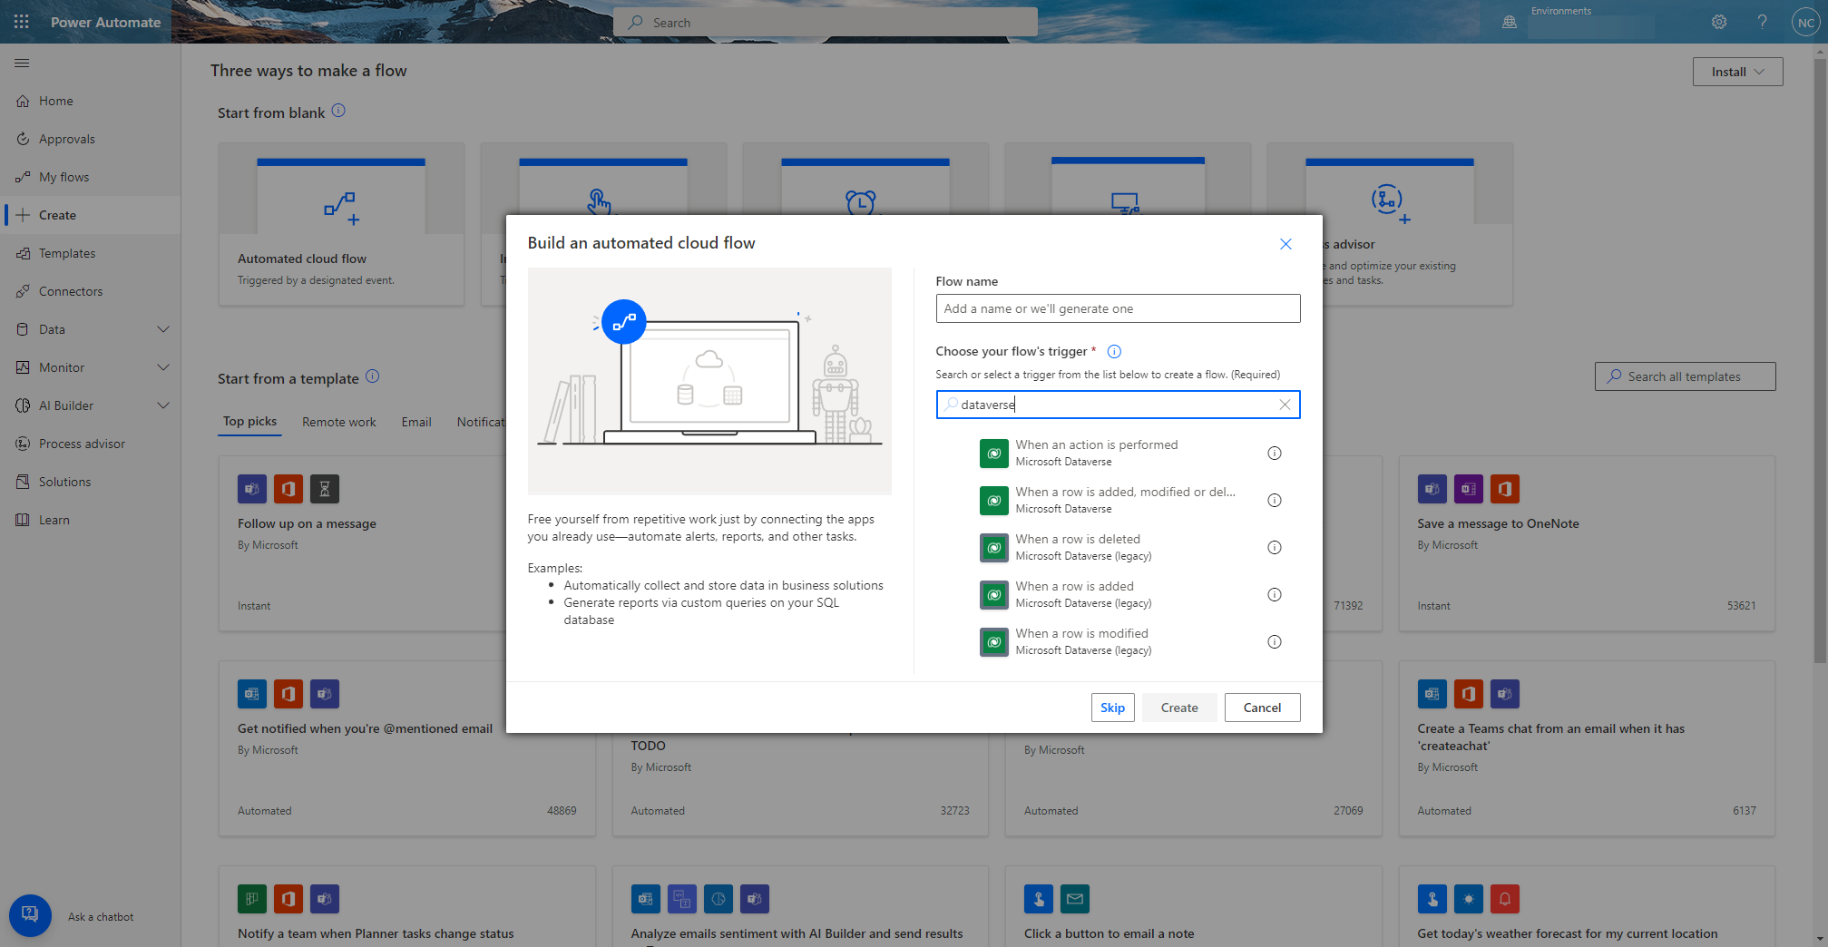
Data Events (not F&O)

Slide 39
Business Events (not F&O)

Slide 40
Dual-Write
Dual-write is an out-of-box infrastructure that provides near-real-time interaction between customer engagement apps and finance and operations apps.
Supported data entities are can “primaried” in 2 different systems at the same time
Synchronous and bidirectional data flow between applications
Synchronization, together with play, pause, and catchup modes to support the system during online and offline/asynchronous modes.
Ability to sync initial data between the applications
Out-of-box setup experience for new customers

Slide 41
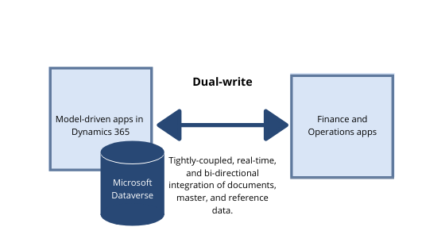
Dual-Write

Slide 42
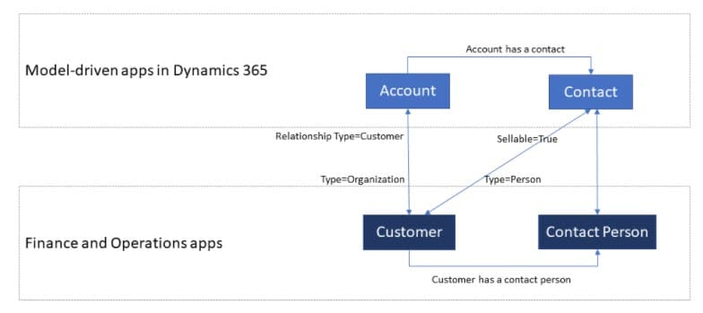
Dual-Write

Slide 43
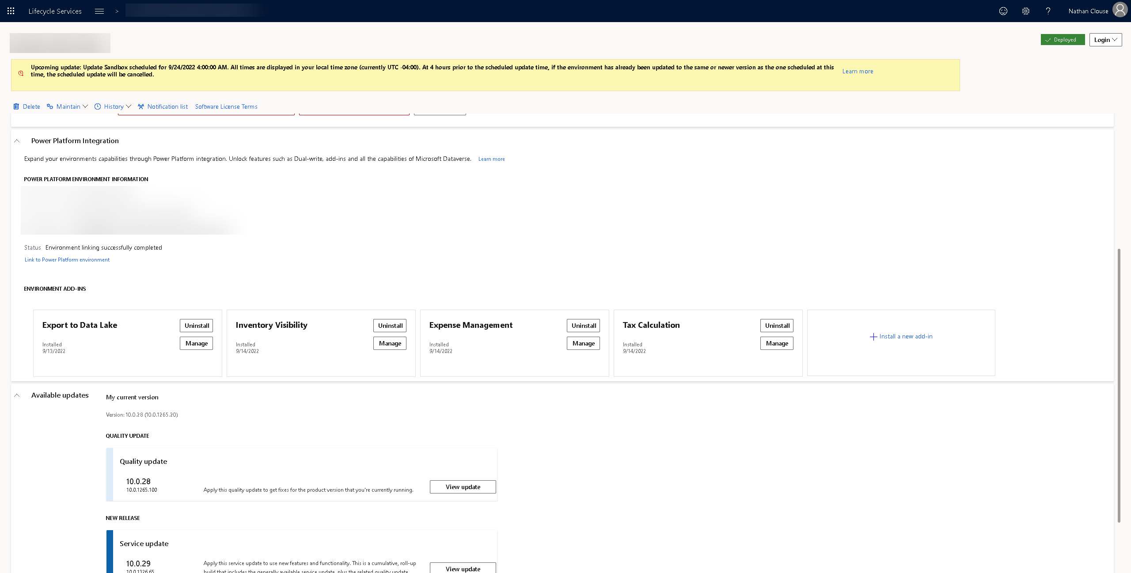
LCS Add-ins

Slide 45
LCS Add-ins

Slide 46
Data events

Slide 47
What is a data event?
Any Create (C), Update (U), or Delete (D) on a data entity they has OData enabled
Ie; if the Create event is enabled on PO Headers V2, an event notification is emitted every time that a new purchase order is created in the database
Notice…..
Data Entity, not table – plan ahead
Notification is emitted
Can only use Data events in environments where the Power Platform is enabled (using LCS)

Slide 48
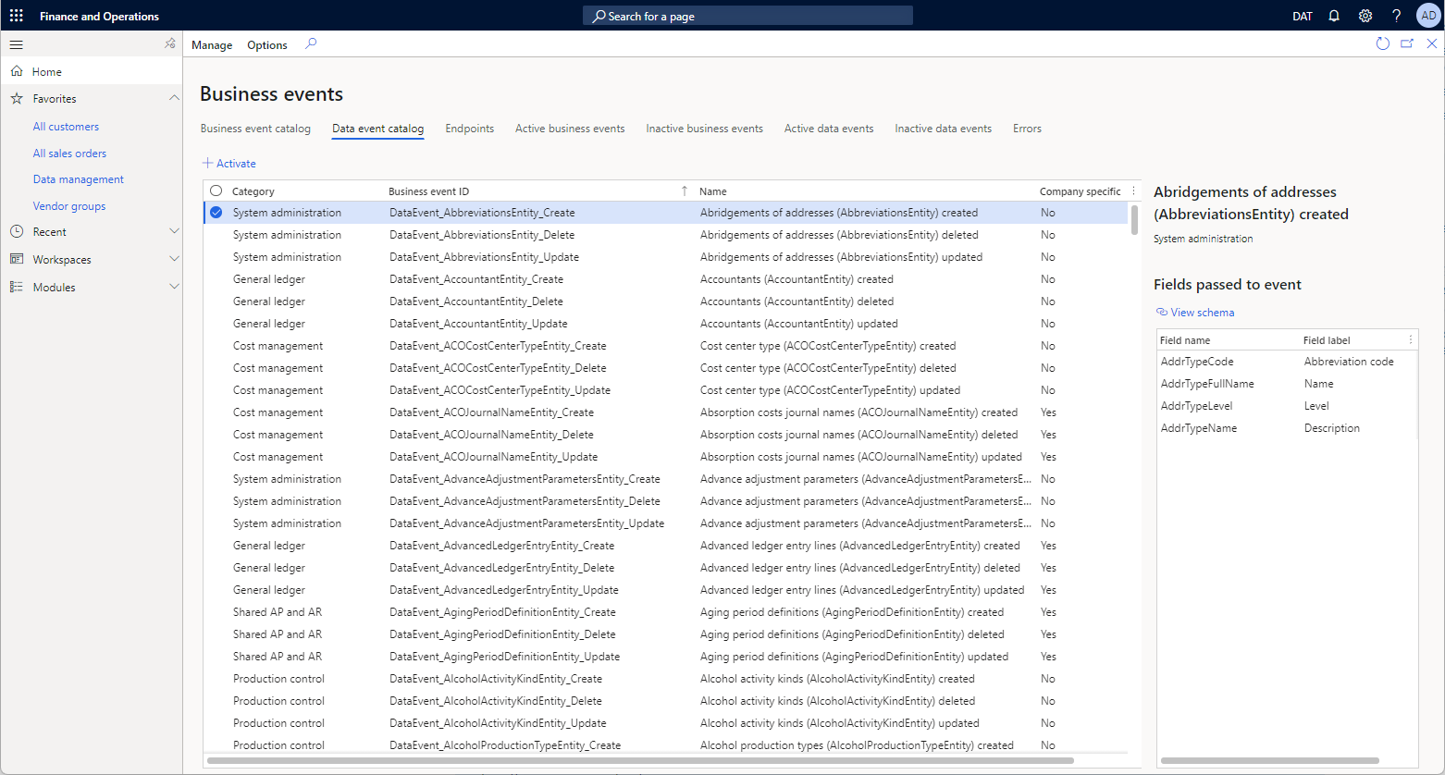
Catalog and what’s included
All Standard entities with OData enabled
Plus, all custom entities with OData enabled

Slide 49
How is it different than a business event?
Business Event
Data Event
Emits notification on process completion
Only available on processes
Small, lightweight message
(generally) high performance
Activated in 1 legal entity or all legal entities
Emits notification when a record operation completes
Only available on record operations
All fields in data entity? Well…
Could have performance issues if overused
Activated in 1 legal entity

Slide 50
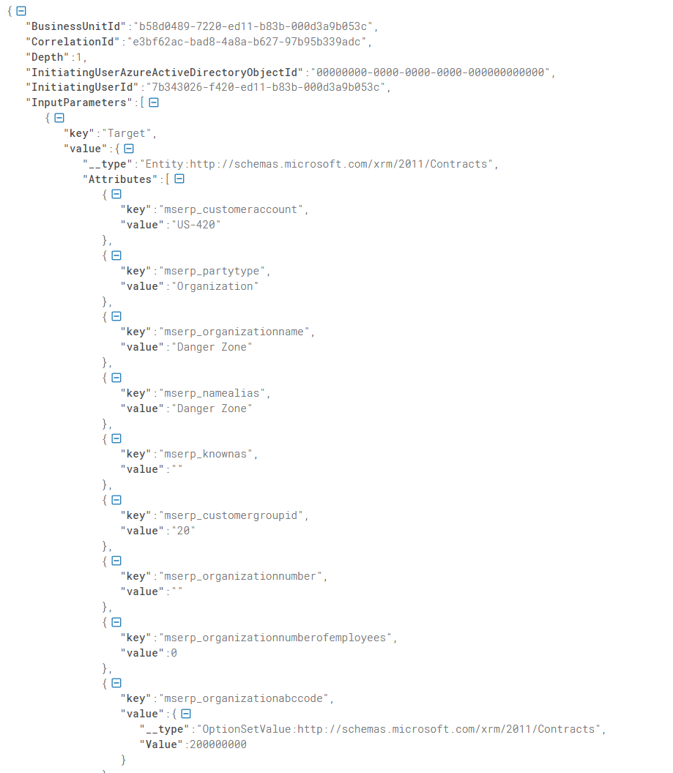

Slide 52
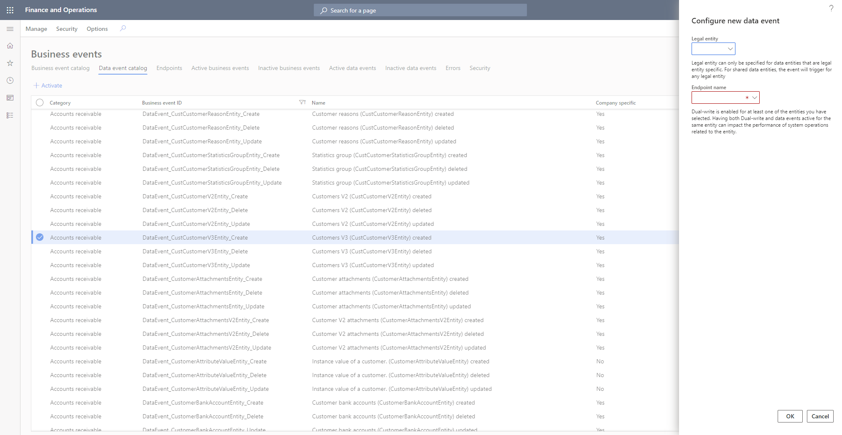

Slide 53
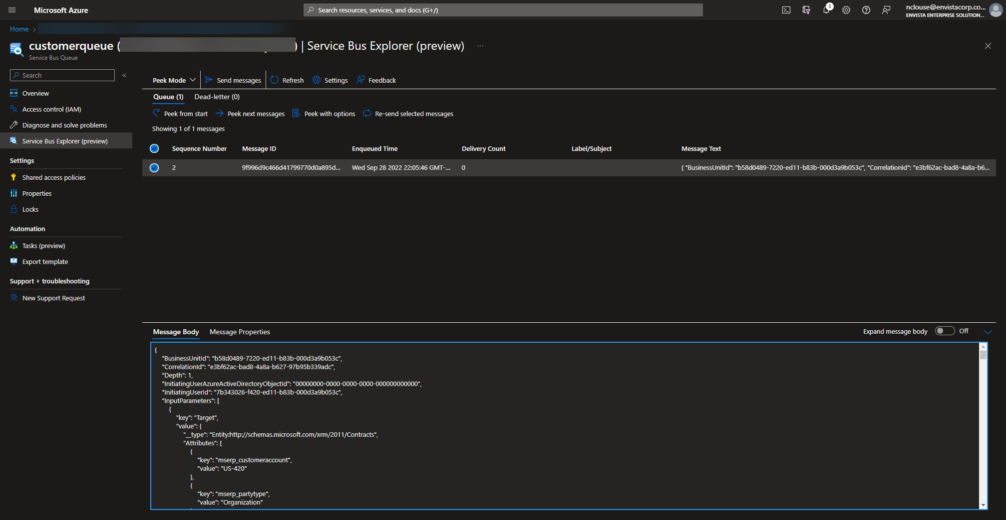

Slide 54

Demo

Slide 55
Notes:
Change tracking enabled on entity for incremental data export. Recurring data job enabled to export file in the queue. Instead of polling ,BE will be received by dataverse connector which will download file from queue and store in blob which can be consumed , can be transformed as per third party system requirements.

Slide 56
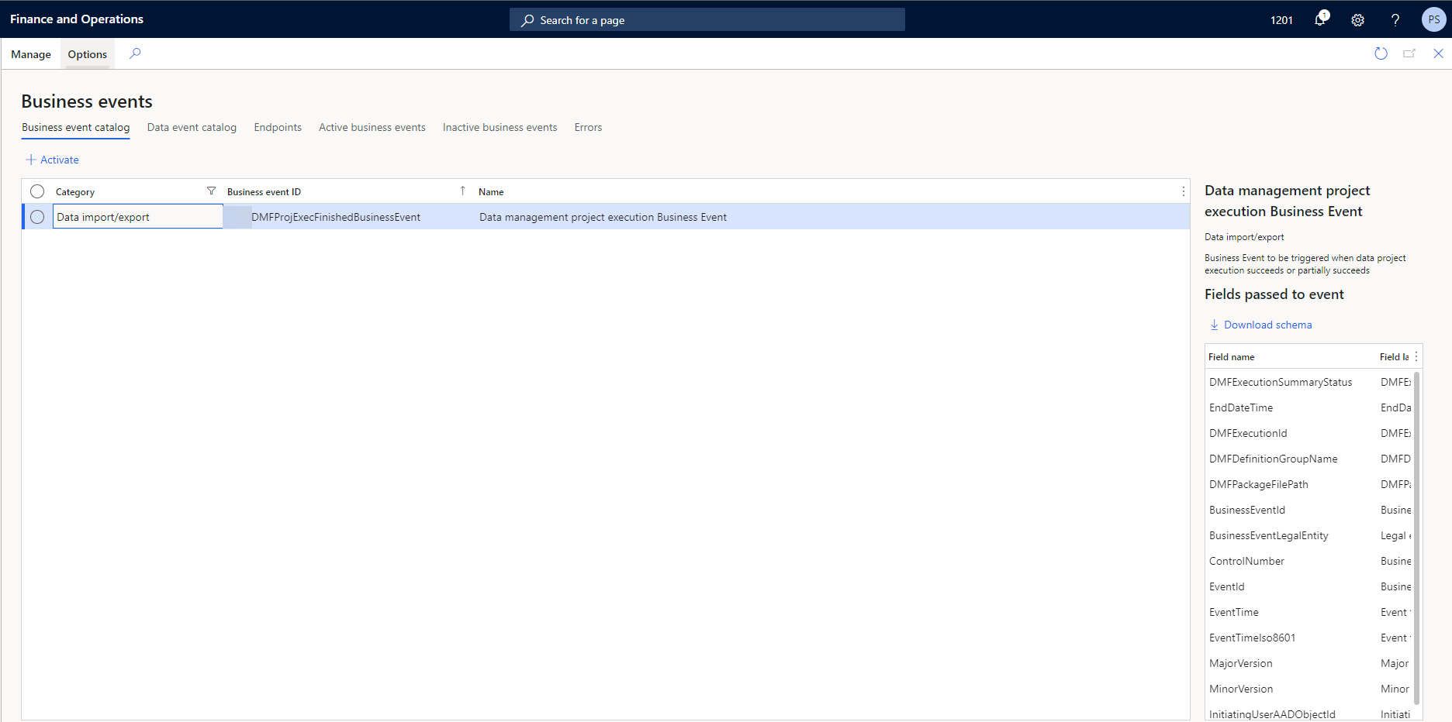
Custom business event in F&O
Notes:
A custom business event created in F&O with fields needed inJSON response.

Slide 57
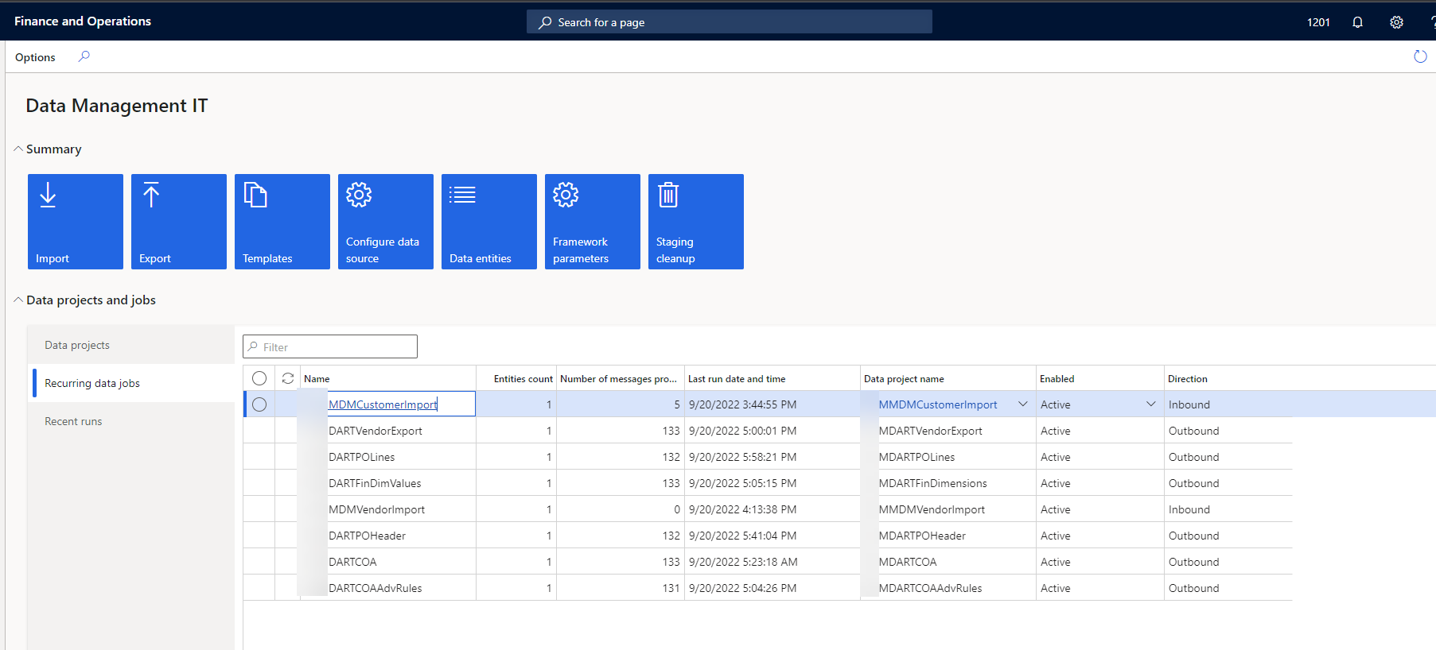
Recurring data project in F&O
Notes:
A recurring data project created in F&O using sys admin workspace (Data management IT tile).

Slide 58
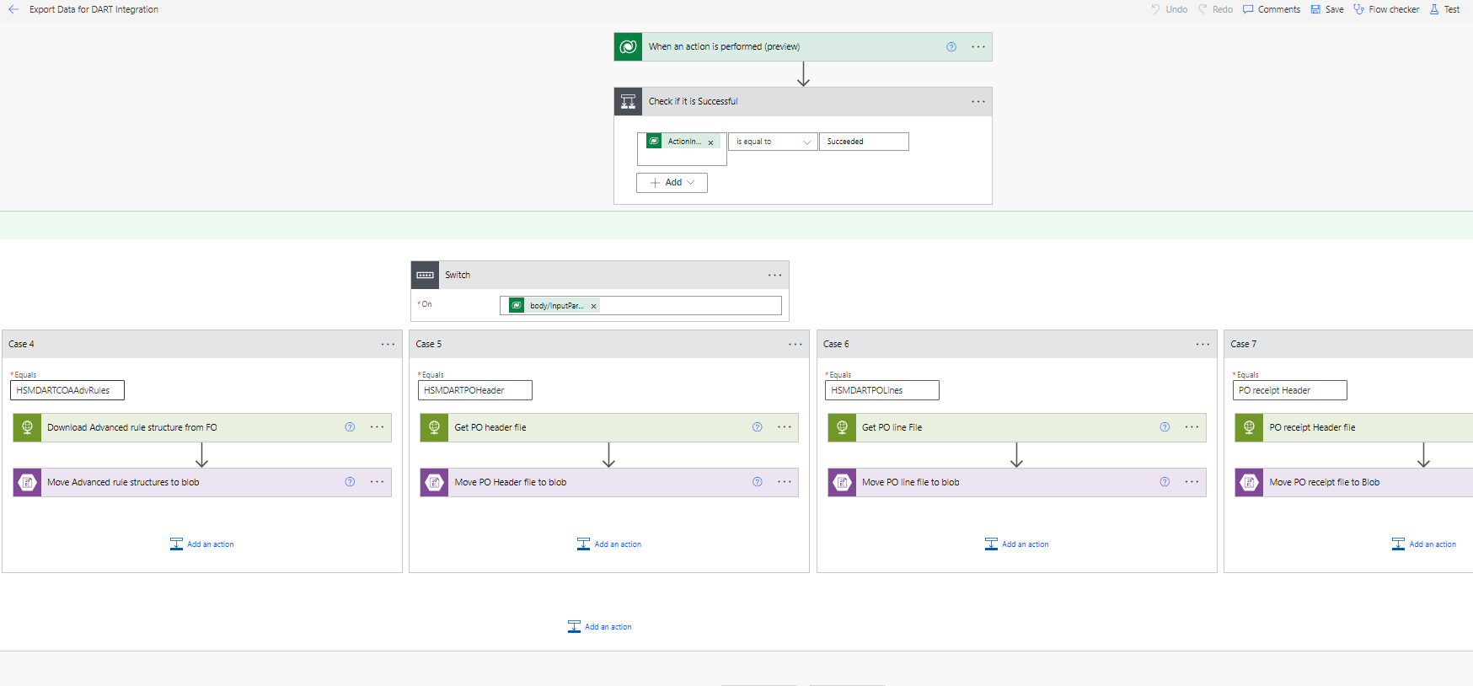
Receive business event using Dataverse
Notes:
When the business event is emitted, it is received by dataverse. With the help of downloadable url directly download file from blob instead of using polling mechanism and calling different data management package API multiple times. File can be in any format supported by DM.

Slide 59
Notes:
When the business event is emitted, it is received by dataverse. With the help of downloadable url directly download file from blob instead of using polling mechanism and calling different data management package API multiple times. File can be in any format supported by DM.

Slide 60
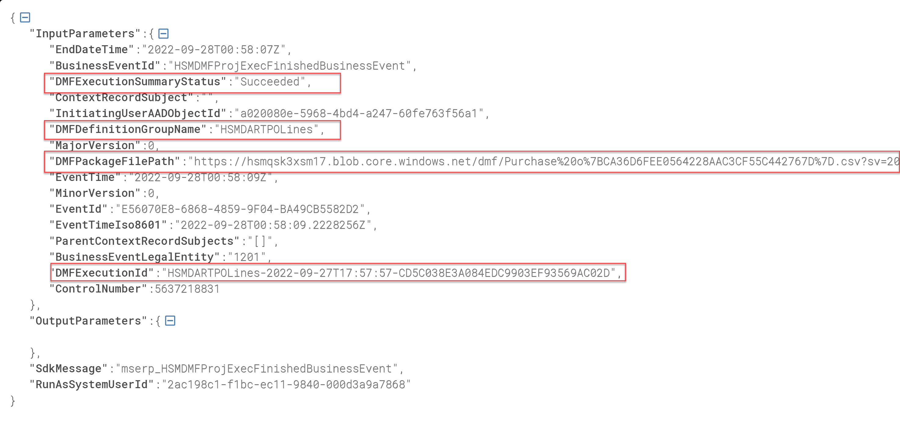
Receive business event using Dataverse
Notes:
A sample payload emitted by BE. Some notable fields which are received by dataverse.

Slide 61
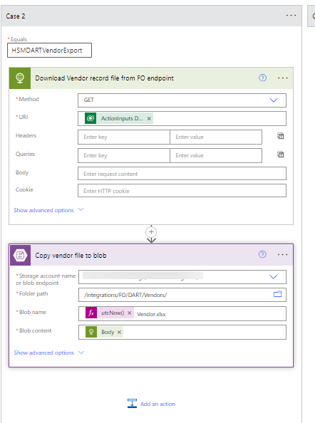
HTTP call to get the file and move to Blob
Notes:
Can be consumed by third party system or can be transformed as needed using function app , ADF etc.
A simple small framework using business event and Dataverse where you can enable any entity in any format in simple two steps
Create data project and enable recurring integration
Add a case statement in power automate flow to route file in desired blob folder.

Slide 62
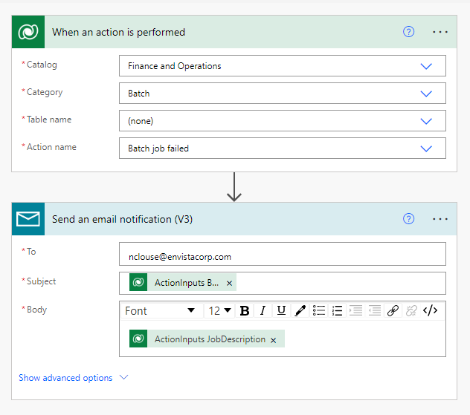
Batch Job Example

Slide 63
Summary
Business Event (F&O)
Dataverse Data Event
Trigger from inside F&O
Lightweight notification
Can emit to outside systems / listeners
Process outcome driven
Can be picked up by Dataverse as actions
Triggers from inside Dataverse
Operation must execute in Dataverse (not just F&O)
Create, update, delete operation

Slide 64
Data Event (F&O)
Triggers from inside F&O on data entity
Create, Update, Delete operations
Send entire data entity as notification payload

Slide 66
Give Away
Also, all of my PowerPoints will be available for download at https://github.com/NathanClouseAX/CommunityPresentations/tree/master/2022 by end of the week

Slide 67


